Slide 1
Nakuja Internship
Edwin Mwiti
Week 1 progress report

Slide 2
Tasks this week
Get acquainted with Avionics and telemetry resources [Issue #4]
Review computer 1 PCB
Review computer 2 PCB
Research on the necessity of having LoRa Modules on the Printed circuit boards
Get acquainted with the on board PCBs controlling the telemetry and flight navigation

Slide 3
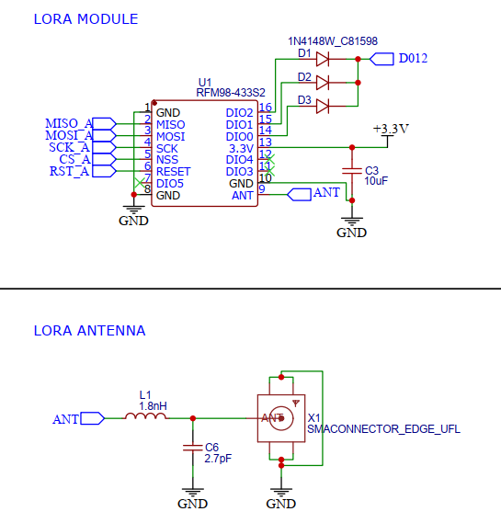
Findings
Computer 1 and 2 were reviewed and the was no need for using LoRa modules on board because of speed requirements

Slide 4
Findings
We instead need to work on designing the relevant Wi-Fi connections required for fast data transmission
Components such as the MPU6050 accelerometer and the BMP180 have very sensitive data that needs to be cleaned and filtered before being used for decision making

Slide 5
Tasks last week
[#1 Research on data transmission]
[#43 Test and receive over LoRa]
[#44 Test send image over LoRa]
[#48 Test max distance of LoRa]
[#45 Test speed and bandwidth of LoRa]

Slide 6
Tasks this week
[#30 Research on camera module]
[#23 Avionics bay design]
[#18 Launch pad design]

